Slide 1
Certificate of Origin
CoO

Slide 2
What is a CoO?
Document declaring in which country a commodity or good was manufactured.
Contains information regarding the product, its destination, and the country of export (e.g. “Made in the USA”, “Made in China”).
Required by many treaty agreements for cross-border trade.
Is an important form because it can help determine whether certain goods are eligible for import, or whether goods are subject to duties.
Records the country of origin that an imported good has come from.
Is often mandated by importing countries and included in trade agreements.
It is used to levy the appropriate import tax, if any apply.
Can exist either in paper or digital format
Must be approved by a customs authority.

Slide 3
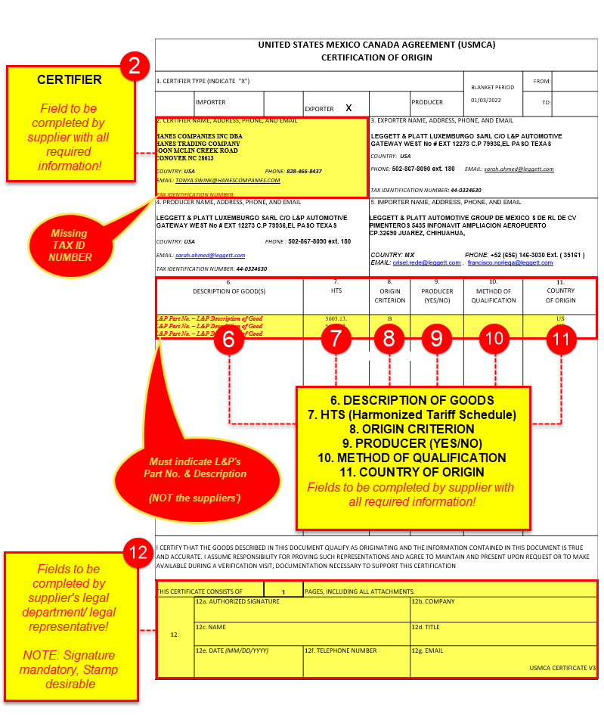
CoO United States Mexico Canada Agreement (USMCA)
https://github.com/criselrede/lap_org_customs/wiki/CoO---United-States-Mexico-Canada-Agreement-(USMCA)

Slide 4
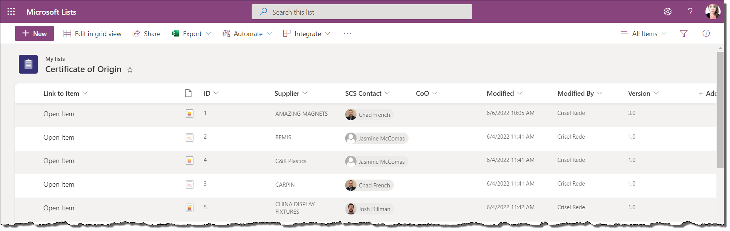
Certificate or Origin online list/ tool
Online repository to upload your suppliers’ CoOs ← Online tool https://leggettplatt-my.sharepoint.com/personal/crisel_rede_leggett_com/Lists/CoO/AllItems.aspx
Where to upload the Certificates of Origin? ← Documentation https://github.com/criselrede/lap_org_customs/wiki/Where-to-upload-the-Certificates-of-Origin%3F
How to ask for feedback about a Certificate of Origin? ← Documentation https://github.com/criselrede/lap_org_customs/wiki/How-to-ask-for-feedback-about-a-Certificate-of-Origin%3F

